Slide 1

My Journey in Medicine Basics
For stable and skillful experience in the near future

Slide 2
Contents
Introduction About Me
How I Found This Program
My Journey in This Program
Important Insights from Lessons
My Goal After This Program

Slide 3
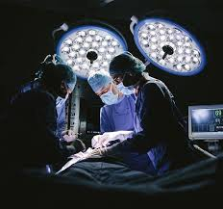
About Me
My name is Maria Abdulshikur, an 11th grade student at Lebawi International Academy.
I aspire to become a general surgeon in the near future.

Slide 4
2. Inspiration to Become a Doctor
I’ve continuously lost dear and loved ones due to minor illnesses — illnesses that could have been healed with just one injection or a simple prescription.
That experience, combined with my deep passion for medicine, inspired me to pursue this path.

Slide 5

3. How I Found This Program
I heard about this program through friends at school and from previous participants who recommended it.

Slide 6

4. Our Journey in This Program
We participated in various assessments, tasks, and quizzes on platforms like Khan Academy and other websites.
We also tackled expert session riddles that challenged our thinking.

Slide 7

5. Evidence of Participation

Slide 8
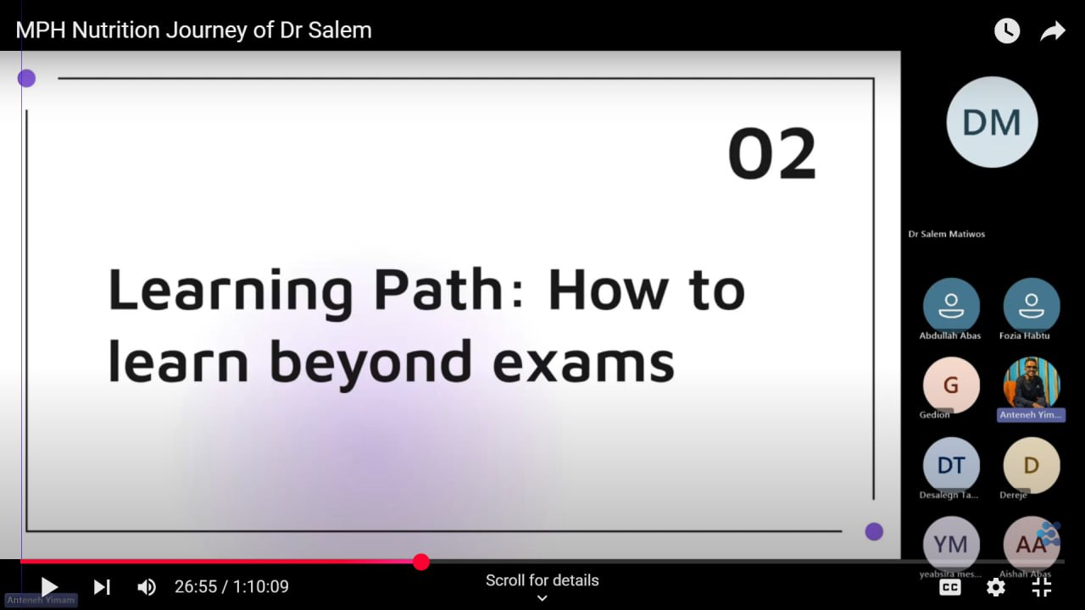
5.1 Sample from Our Journey
"Learning Path: How to Learn Beyond Exams" led by Dr. Salem Matiwos. It emphasized developing long-term skills and going beyond just passing tests.

Slide 9
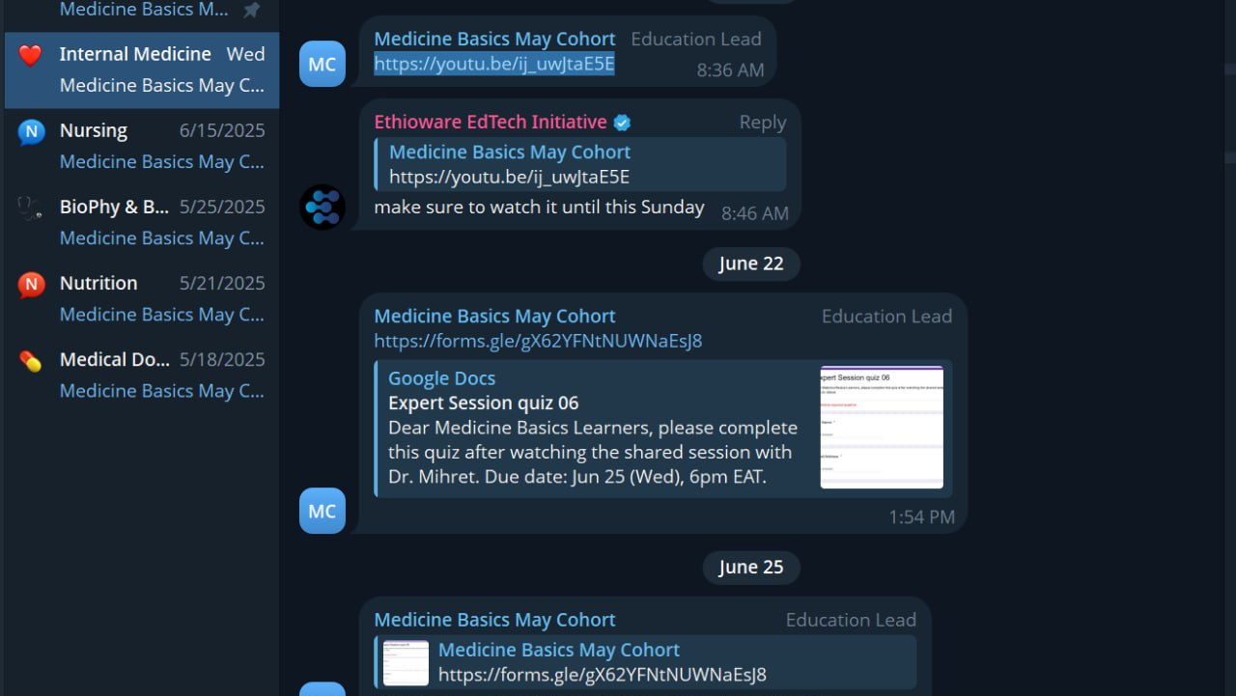
5.2 Communication and Task Coordination
This screenshot shows how we received quizzes, deadlines, and expert session links through a Telegram group led by the Education Team. It reflects how our tasks were shared, organized, and tracked throughout the Medicine Basics program.

Slide 10
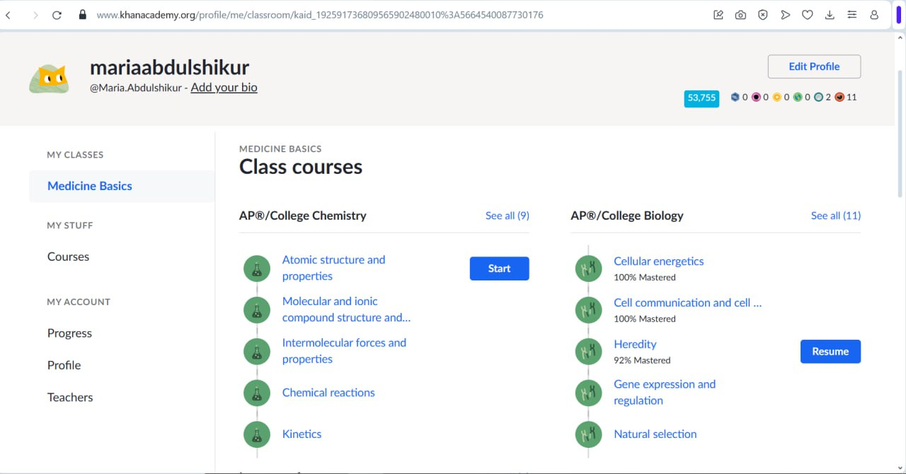
5.3 Learning Through Khan Academy
This screenshot shows my progress in the Medicine Basics course on Khan Academy. I explored subjects like College Chemistry and Biology, mastering topics such as cellular energetics, chemical reactions, and heredity, which deepened my understanding of medical science.

Slide 11

6. Important Insight

Slide 12
Important Insight #1
Dr. Salem reminded us that life doesn’t always go as planned:
"Always have back up for ur main goal which is plan B because you don’t know where yourr future takes you"
This taught me that having a Plan B isn’t weakness — it’s wisdom. It means being prepared, flexible, and ready for whatever comes next.

Slide 13
Important Insight #2
Dr. Mihiret said something that really stayed with me:
"No matter how much a person says they are busy, they have to make time for the people that got them here which is family"
This reminded me that success means nothing without the people who supported you — and they deserve your time no matter how busy life gets.

Slide 14
Important Insight #3
Dr. Loza shared an honest truth about medicine:
"Medicine might take your light due to the stress and mental breakdown but always remember that your motivation is what keeps u going and always be confident to try different experiments during practical (clinical) sessions"
This reminded me that even when it’s tough, my passion is what keeps me moving forward — and I should never stop being curious.

Slide 15
7. My Goals After This Program

Slide 16
Short-Term Goal
I plan to join similar programs and volunteer in fields related to medicine.
I want to make sure I'm mentally prepared and practically equipped for university and my future career.

Slide 17
Long-Term Goal
I aim to open a health institution where people from all economic backgrounds can receive treatment
Save lives from diseases that can be cured early.

Slide 18
Thankyou!

